Slide 1
Object-Oriented Analysis and Design using JAVA
B.Tech (CSE/IT) 5th SEM
2020-2021
Lecture-21 Activity diagram examples

Slide 2
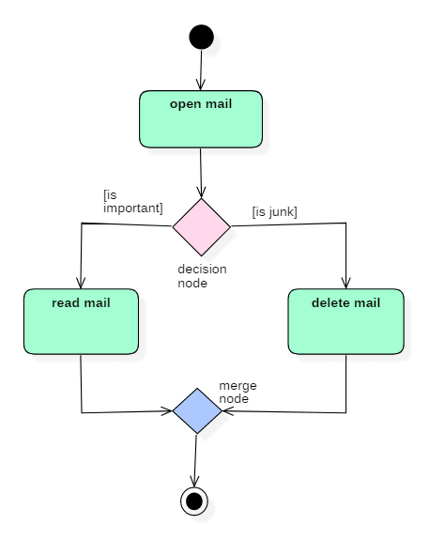
Activity diagram for processing e-mails
Reference: https://www.guru99.com/uml-activity-diagram.html

Slide 3
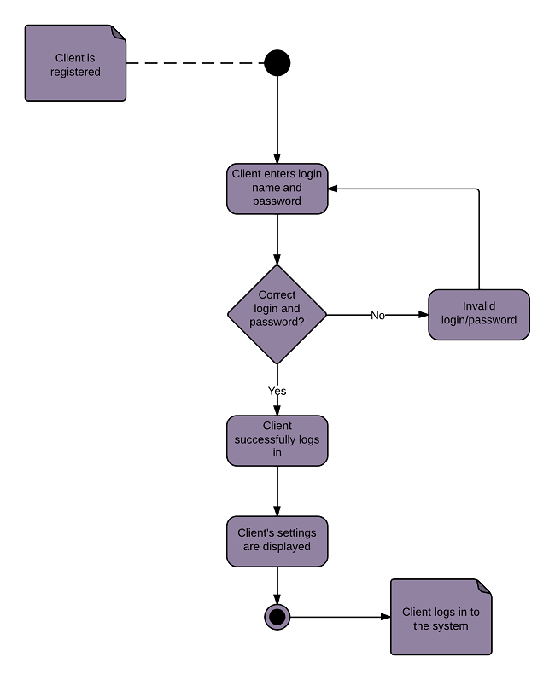
Activity diagram for login page
Reference: https://www.lucidchart.com/pages/uml-activity-diagram

Slide 4
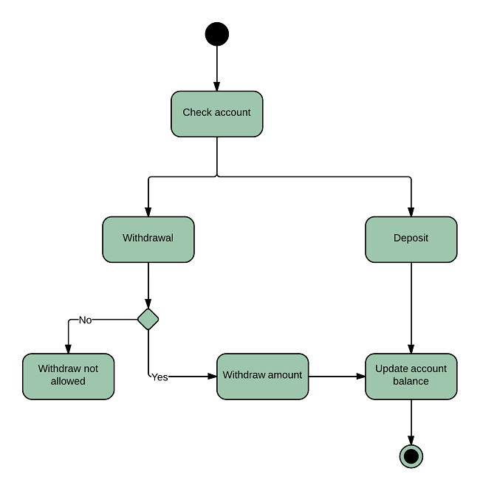
Activity diagram for a banking system
Reference: https://www.lucidchart.com/pages/uml-activity-diagram

Slide 5
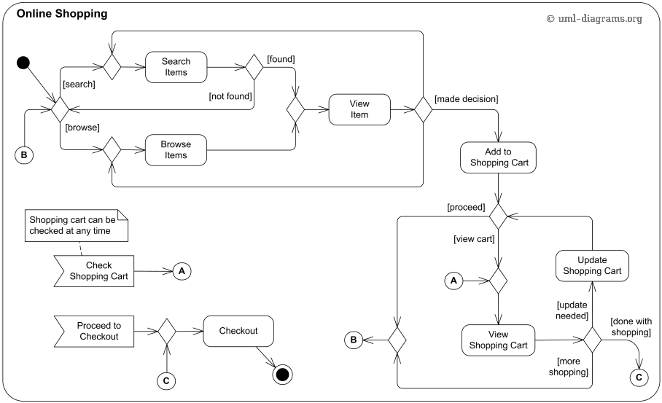
Activity diagram for a online shopping
Reference: https://www.uml-diagrams.org/activity-diagrams-examples.html

Slide 6
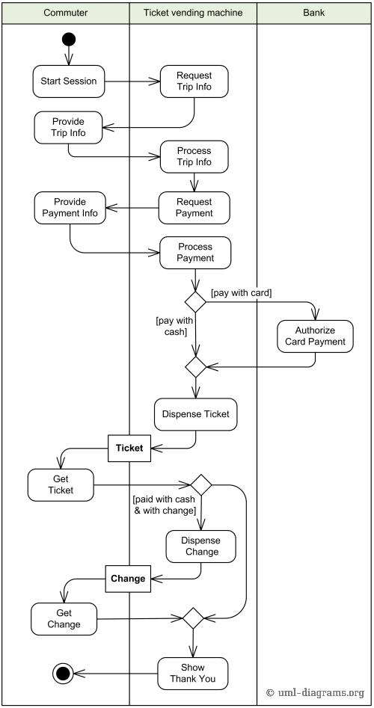
Activity diagram for a ticket vending machine
Reference: https://www.uml-diagrams.org/activity-diagrams-examples.html

Slide 7
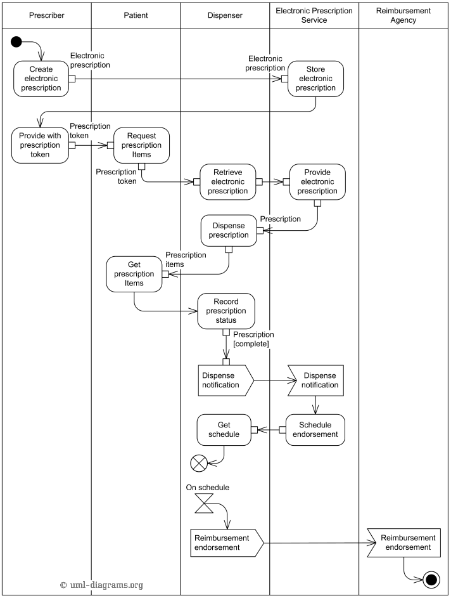
Activity diagram for a electronic prescription
Reference: https://www.uml-diagrams.org/activity-diagrams-examples.html

Slide 8
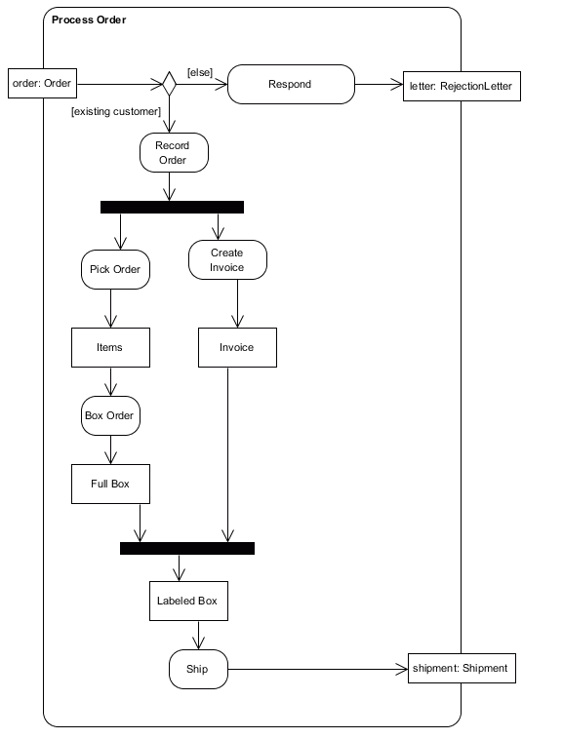
Activity diagram
Identify all of the activities in this diagram.
Identify all of the object/data nodes in this diagram.
Identify all of the actions in this diagram.
Identify all of the decision nodes in this diagram.
Identify all of the fork nodes in this diagram.
Identify all of the join nodes in this diagram.
Identify a control flow in this diagram.
Identify a data flow in this diagram.
Reference: https://w3.cs.jmu.edu/bernstdh/Web/CS345/study-aids/exam1-sample.php

Slide 9
Key references
Unified Modeling Language (UML): Complete Guide & Examples
-By James Rumbaugh, Ivar Jacobson, Grady Booch
https://www.guru99.com/uml-activity-diagram.html
https://www.uml-diagrams.org/activity-diagrams-examples.html

Slide 10
Thank You

